Slide 1
Ccbr1045 Update
2020.3.18

Slide 2
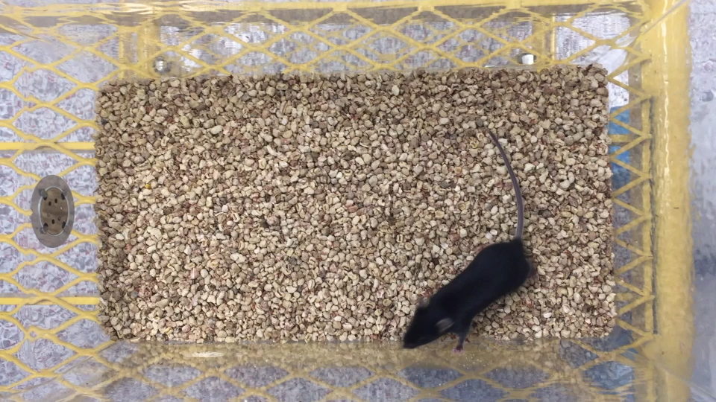
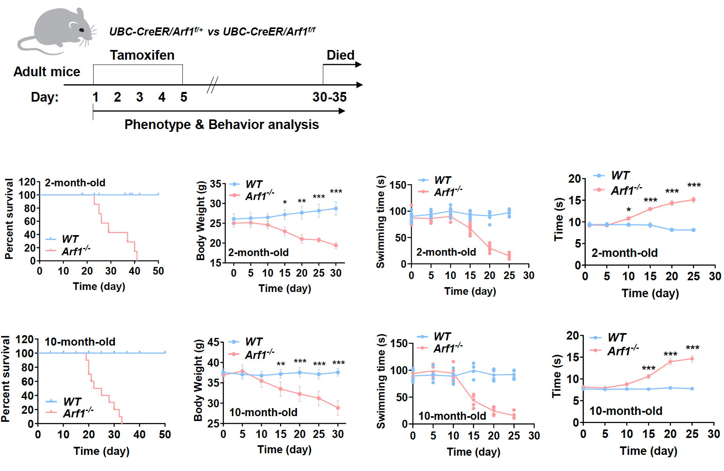
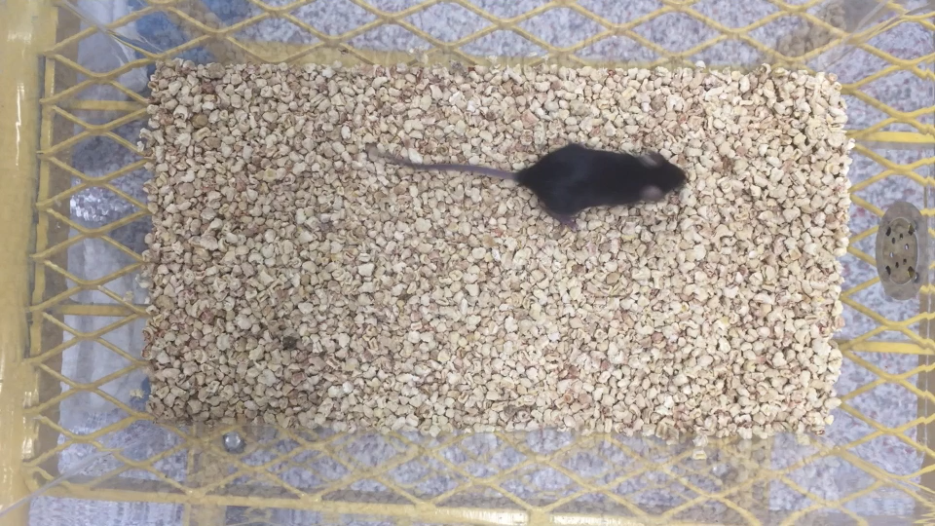
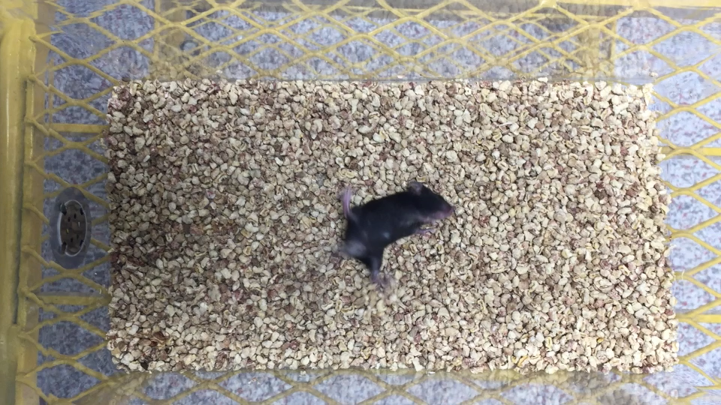

Slide 3
Arf1 ablation induces neurodegenerative behaviors in adult mice
Arf1 deficiency promotes demyelination, axon degeneration, synapse loss, and neurodegeneration.
Arf1 ablation in cancer stem cells promoted an IFNγ- mediated antitumor immune response (Wang et al., 2020)
The slow traveling in the balance beam tests, poor neurological score, synapse loss, axon demyelination, and axon degeneration associated with Arf1-ablated mice were almost completely suppressed in IFNγ-deficient mice
IFNγ is a major downstream component in the Arf1-ablation-induced neurodegenerative pathway
Arf1 knockdown in neurons promotes production of ATP and peroxided lipids, which together regulate caspase-1 activation and IL-1β production in microglia. Increased IL-1β was significantly suppressed by knocking down ApoE (sh-ApoE) (Figures 5i and S15k), indicating that the ApoE-mediated lipid transportation is important for IL-1β induction in microglia.
knocking down Arf1 in neurons increases ROS and promotes the release of ATP, chemokines, and peroxided lipids; ATP and peroxided lipids activate the inflammasome to produce IL-1β in microglia; the chemokines may help to recruit γδ T cells to meninges; and the IL-1β activates γδ T cells to produce IFNγ, which enters parenchyma to activate a microglia–A1 astrocyte–C3 cascade to damage neurons and oligodendrocytes for neurodegeneration.
Arf1-ablated neurons first release peroxided lipids and ATP that activate an NLRP3 inflammasome in microglia for secreting IL-1β; the IL-1β, together with elevated chemokines, recruits and activates γδ T cells in meninges to produce IFNγ; the IFNγ then enters into parenchyma and activates the IFNγ receptor–Stat1 pathway in microglia to induce TNFα and IL-1α, which might further activate astrocytes to produce C3 for destruction of neurons and oligodendrocytes (Figure 7e).

Slide 4
NDs often begin with neuronal injury or disease and propagate through neuroinflammation and immune response. However, until now, the mechanisms by which injured neurons activate primary neuroinflammation and a T-cell-mediated neuropathology remained elusive. Many questions remain. First, do the neurons directly activate microglia, neuroinflammation, and T-cell immunity?

Slide 5
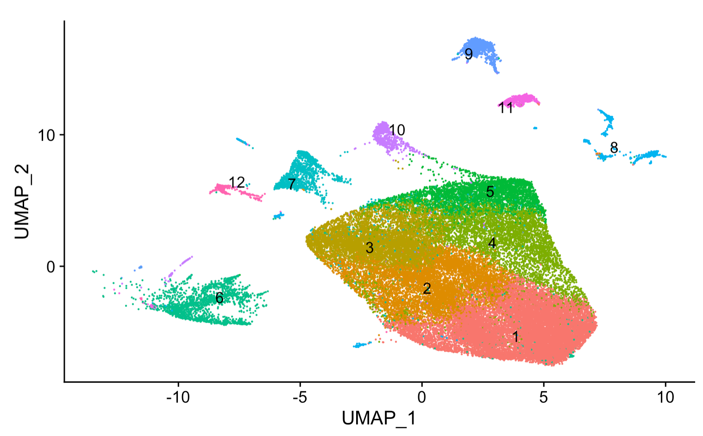

Slide 6
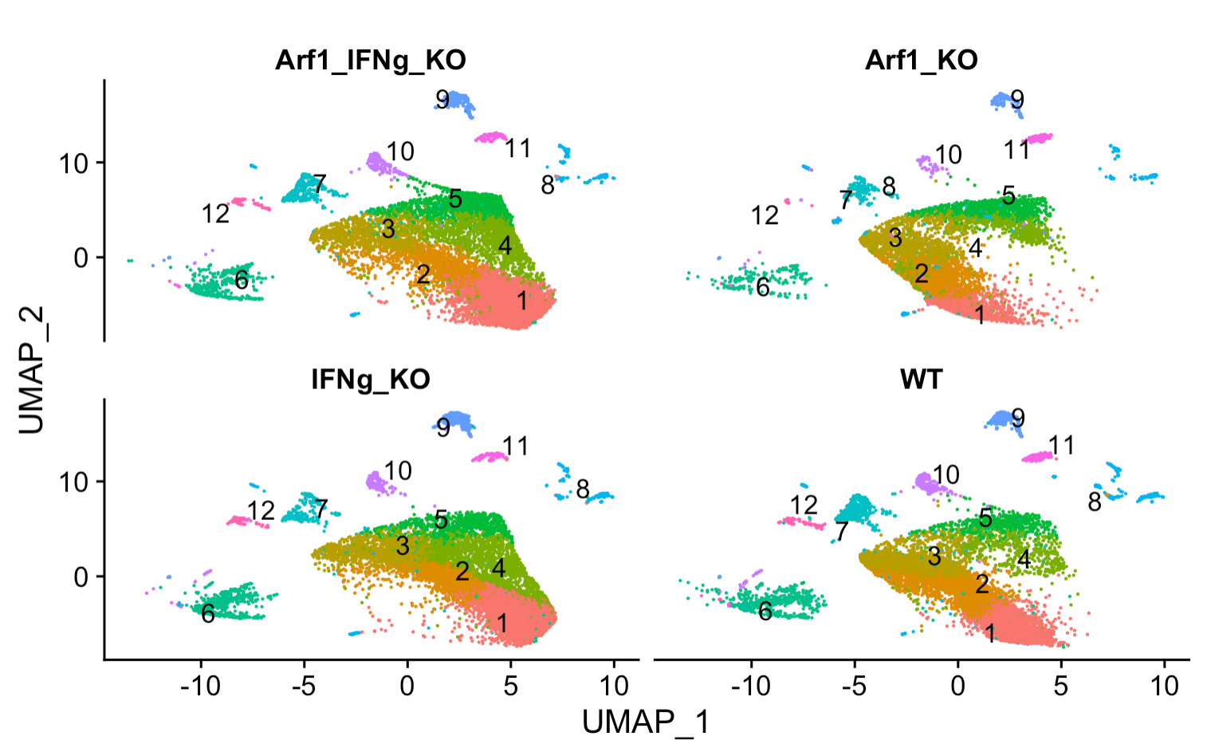
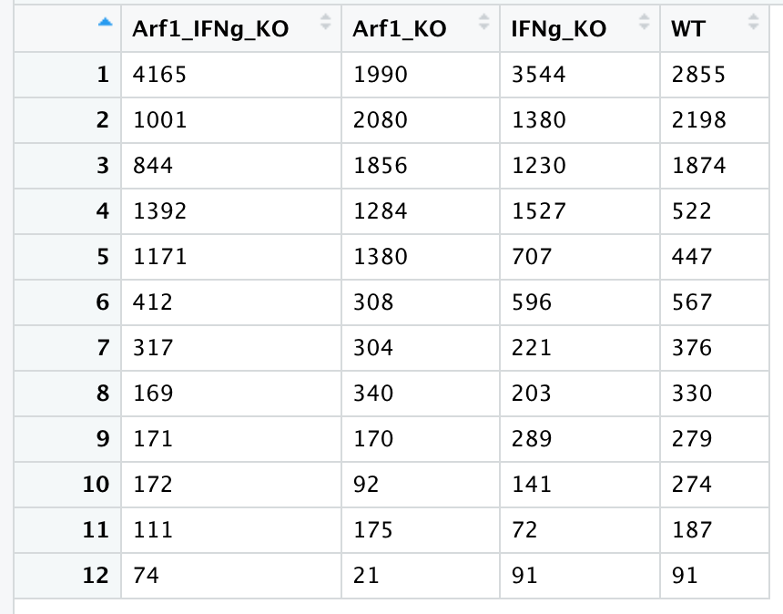
Only microglia cells – reshaped with 0.3 resolution into 12 microglia subclusters
Number of microglial cells for each cluster in each sample

Slide 7
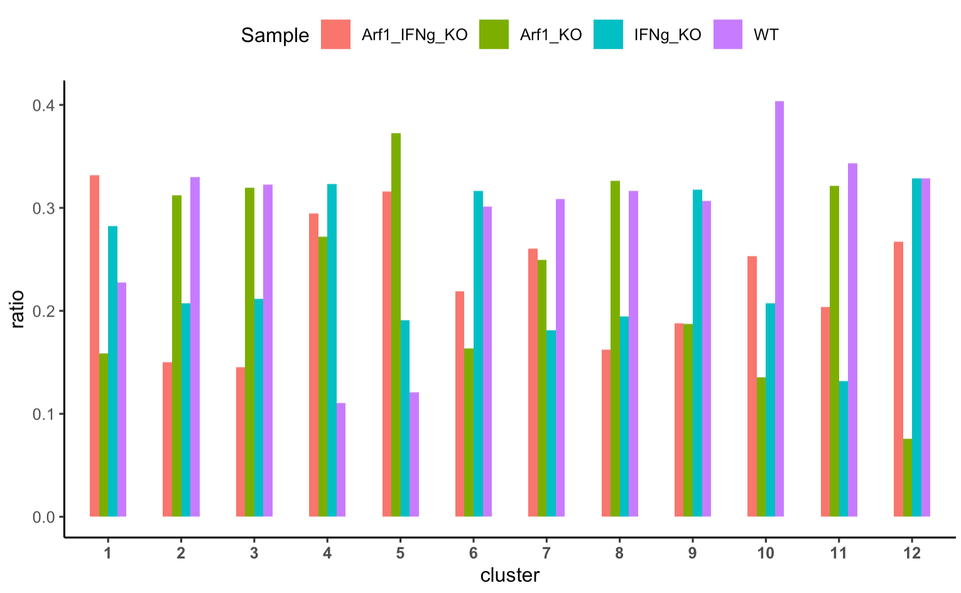
Arf1_KO is enriched in Cluster 5
depleted
enriched
***
***
depleted
depleted
depleted
***
***
***
Chi-square test: P < 0.05 Sig
Notes:
cluster13.061809e-414.408523e-1171.463532e-211sigsigcluster25.324500e-021.578925e-373.133855e-97nsnscluster37.807314e-013.716381e-333.241908e-96nsnscluster42.514975e-802.984808e-063.437892e-02sigsigcluster52.295357e-1213.120161e-542.121216e-05sigsigcluster61.721496e-162.082738e-192.597737e-04sigsigcluster78.583888e-034.063192e-046.277701e-01signscluster87.407008e-015.617508e-093.288811e-14nsnscluster91.493100e-062.370031e-079.806000e-01signscluster101.039198e-173.695263e-037.801740e-06sigsigcluster115.981977e-013.197678e-112.528252e-04nsnscluster125.737170e-095.360490e-091.739415e-06sigsig

Slide 8
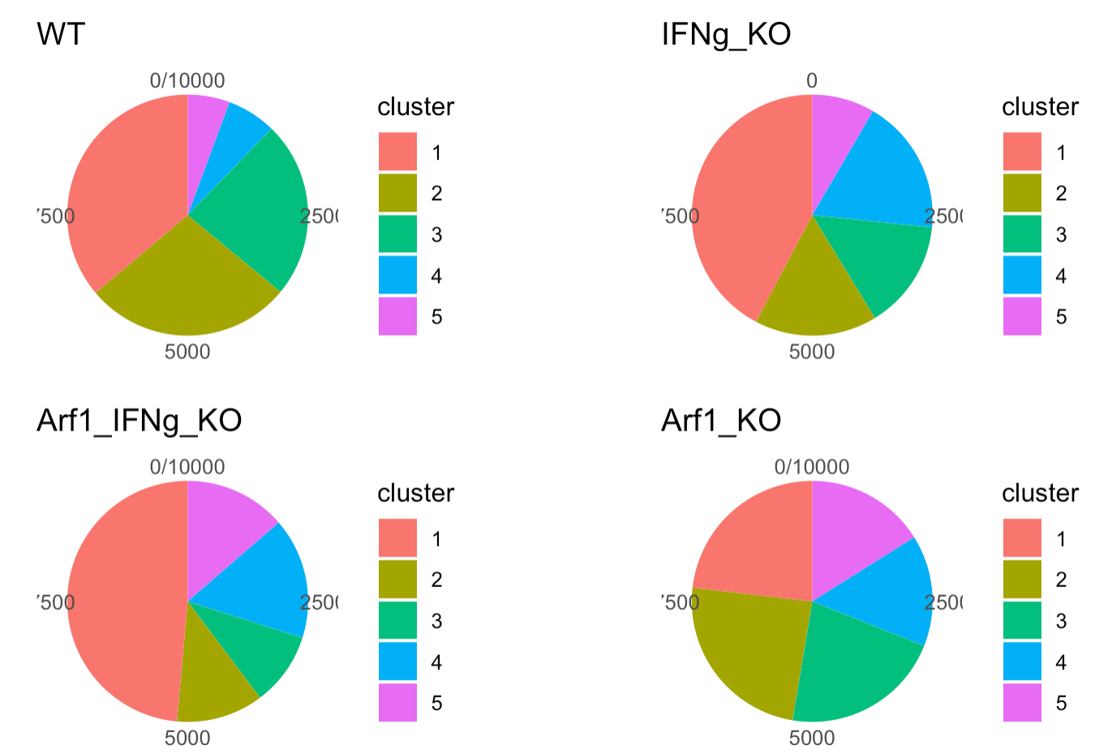
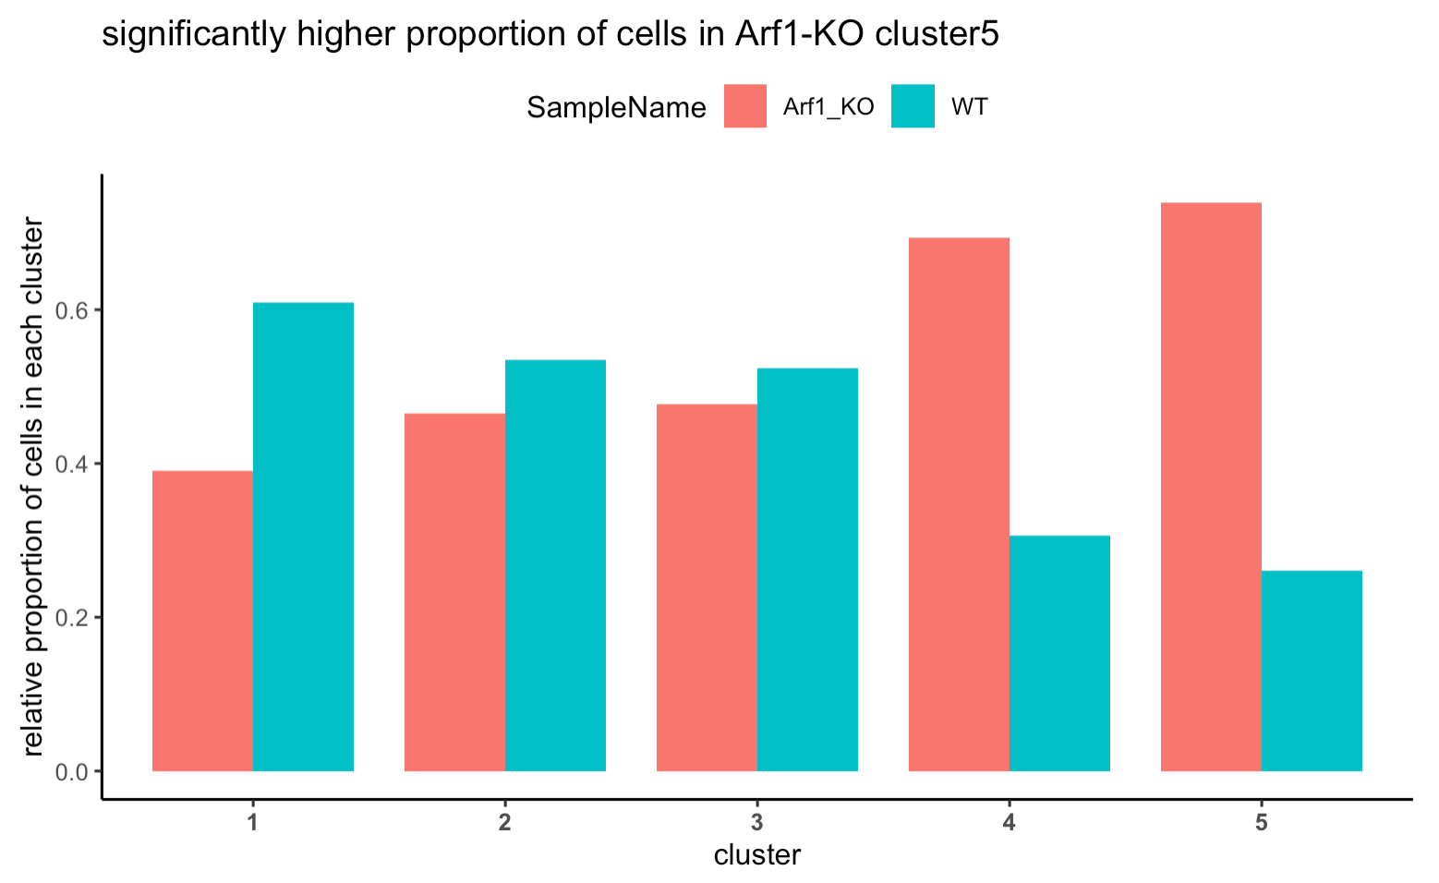
P = 5.54e-129
Relative proportion cluster

Slide 9
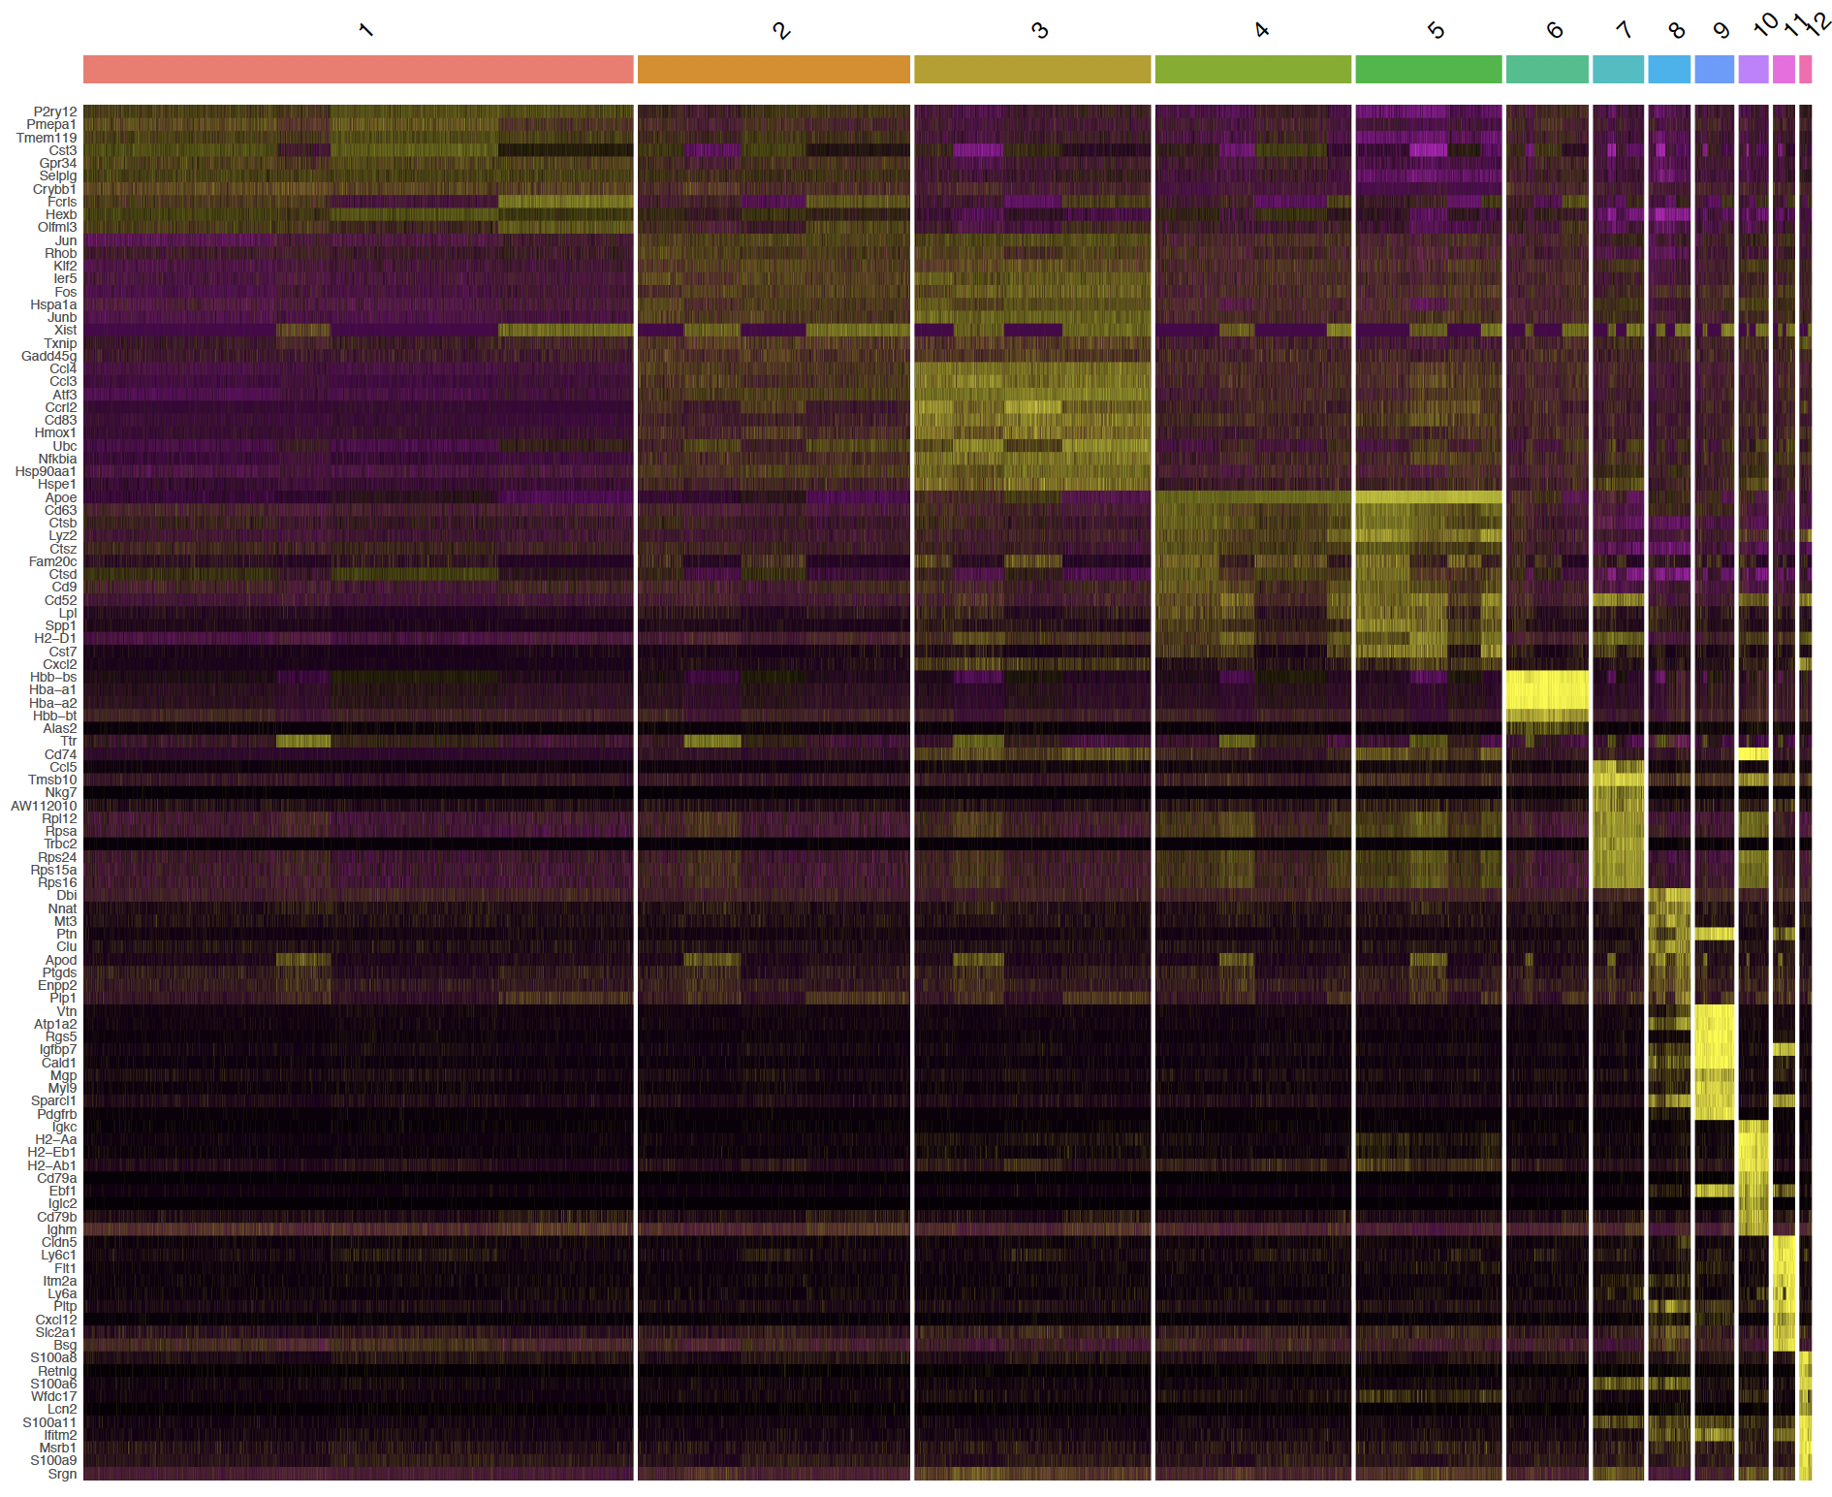
Markers (top 10 by average fold change) for each microglia subcluster

Slide 10
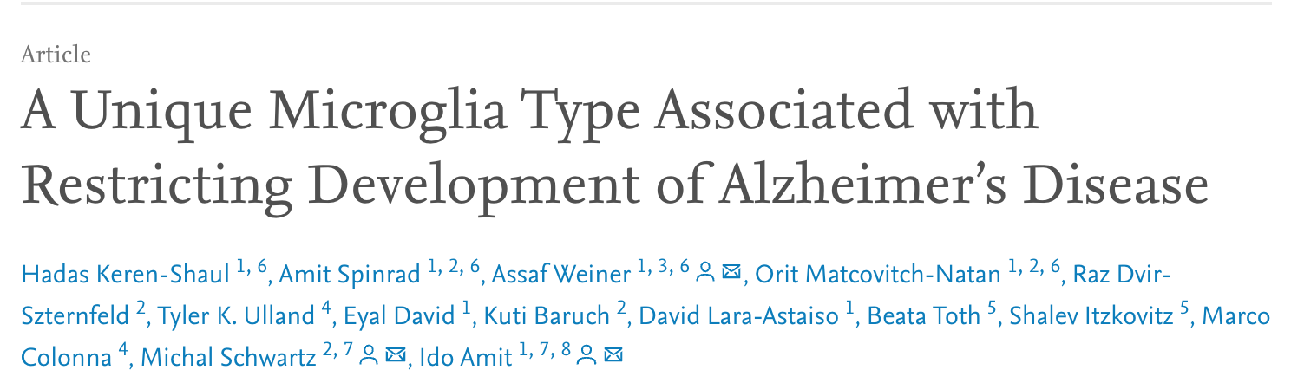
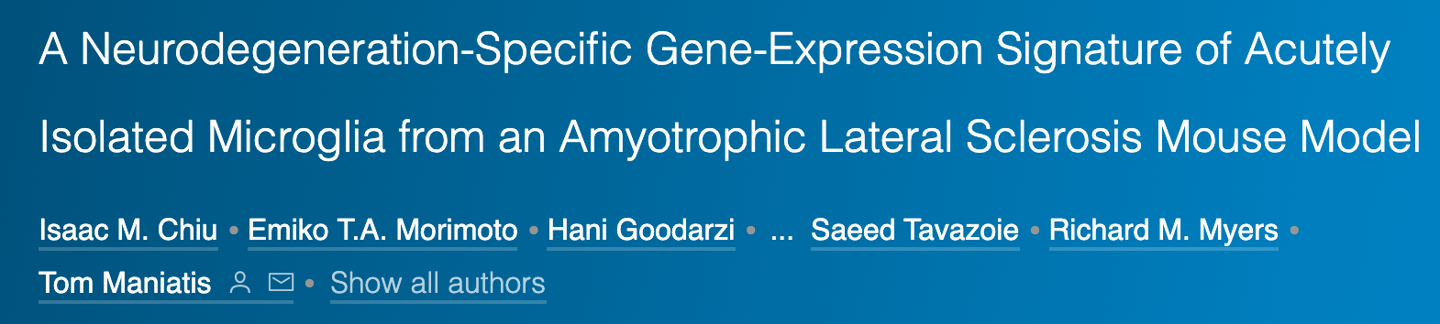
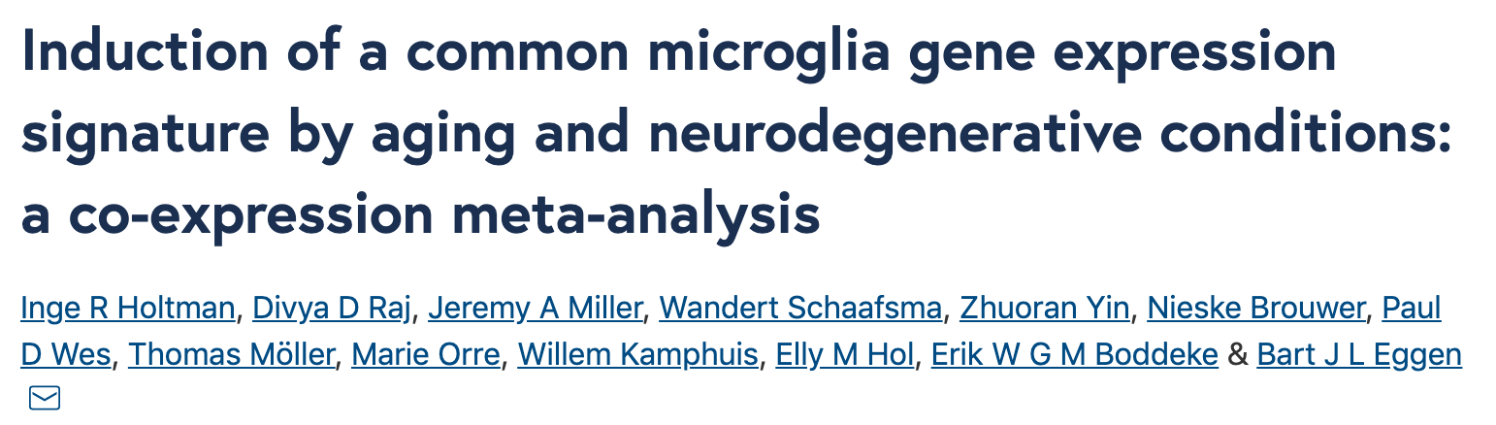
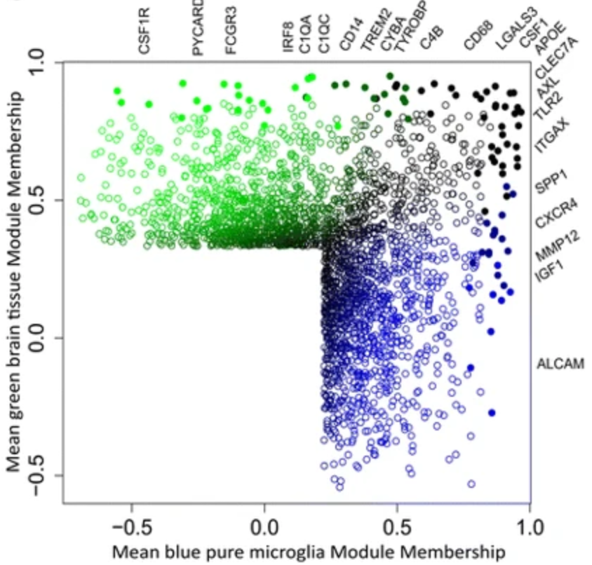
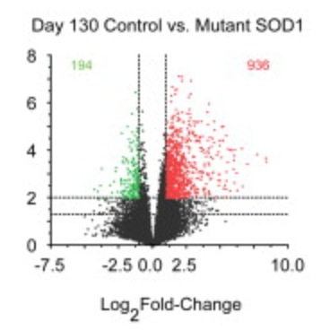
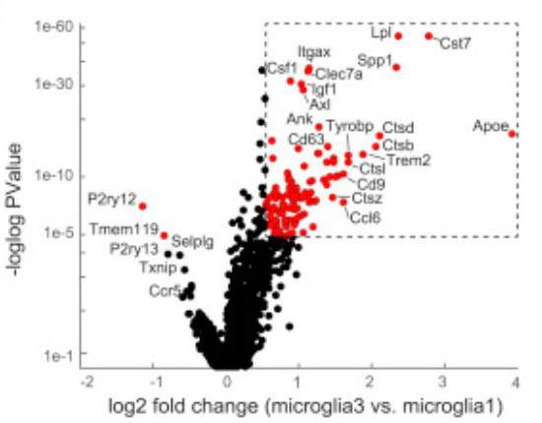
Alzheimer’s disease (AD)
Amyotrophic lateral sclerosis (ALS)
aging
Signed.value = sign(logFC) * log10(Pvalue) * abs(logFC) * -1
Disease
-
normal
Arf1 - WT

Slide 11
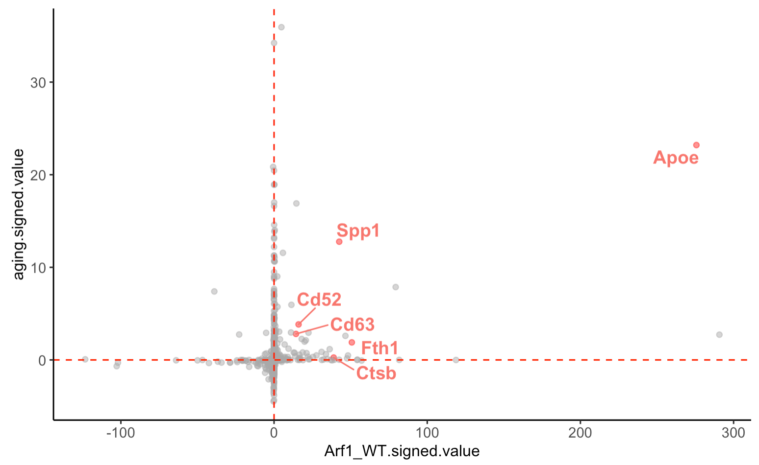
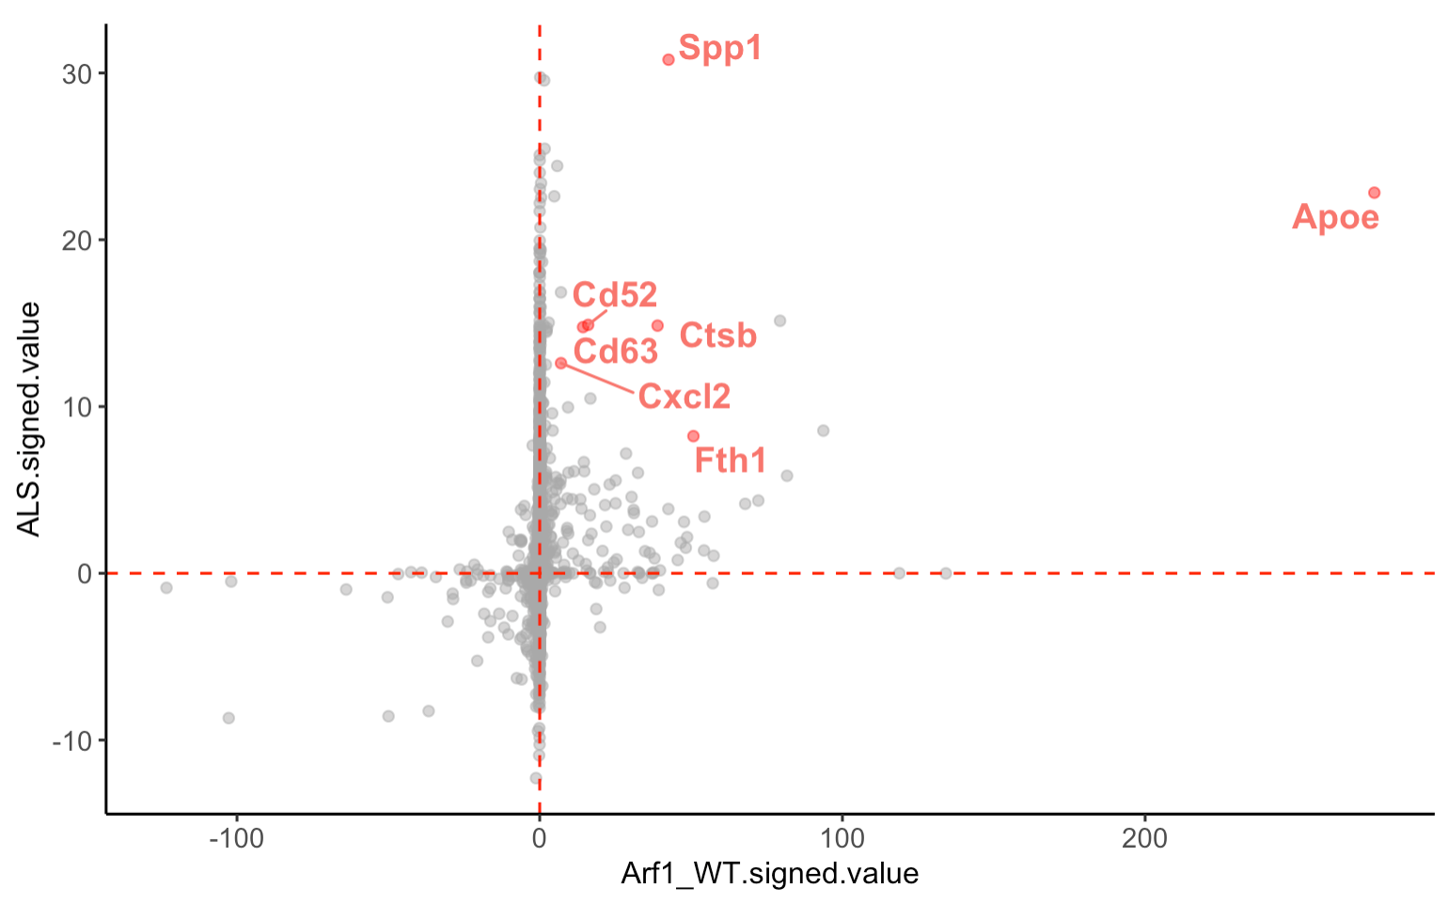
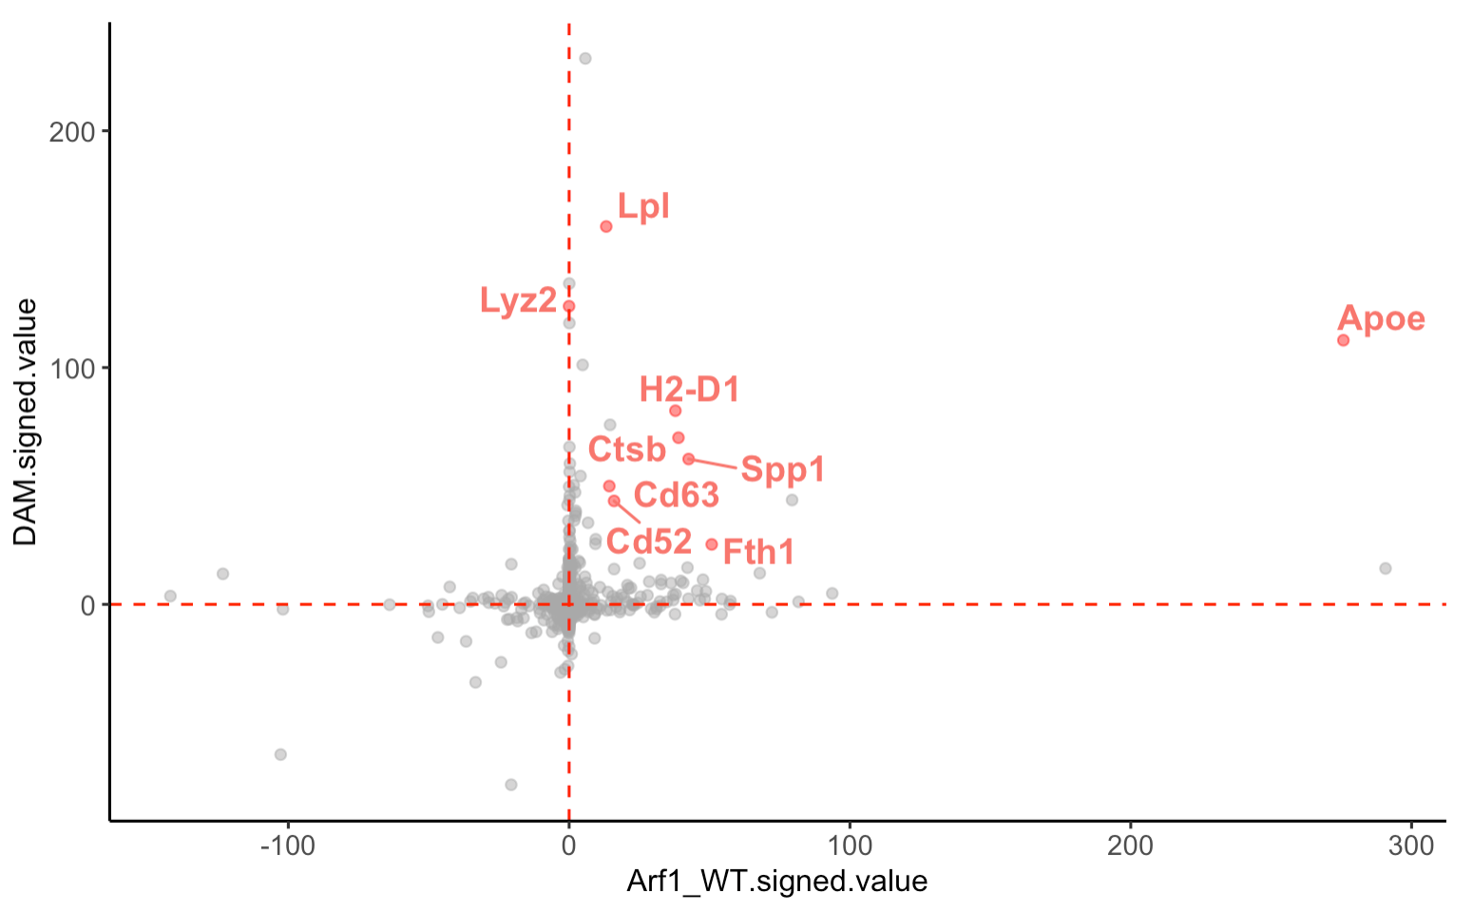
Aging
Top markers in both Cluster 5 and Arf1 include some of the well-known neurodegenerative disease risk genes
Amyotrophic lateral sclerosis (ALS)
Alzheimer’s disease (AD)
late-onset
Alzheimer's disease
Notes:
The most common gene associated with late-onset Alzheimer's disease is a risk gene called apolipoprotein E (APOE).

Slide 12
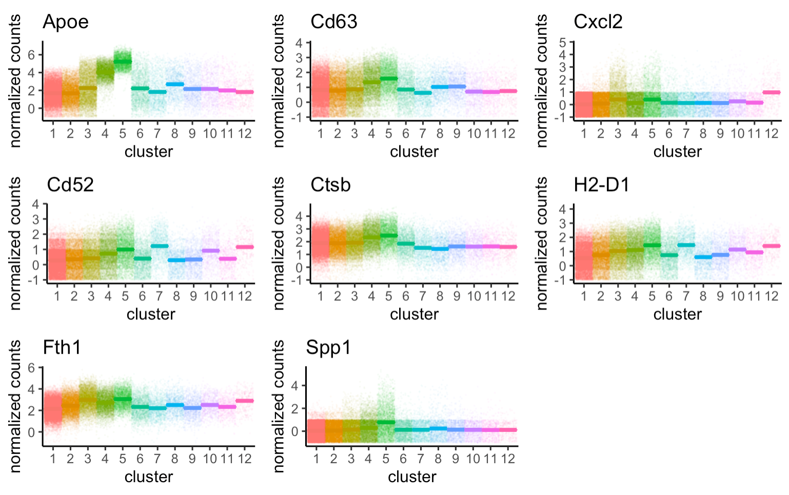
associated with late-onset Alzheimer's disease
Top markers for Cluster 5 include many known disease risk factors
Notes:
The most common gene associated with late-onset Alzheimer's disease is a risk gene called apolipoprotein E (APOE).

Slide 13
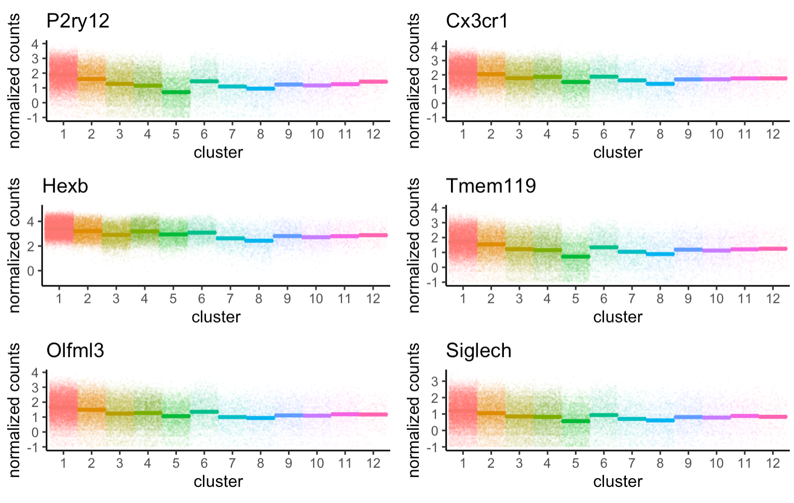
Top marker of Cluster 1 include mostly “microglial marker genes”

Slide 14
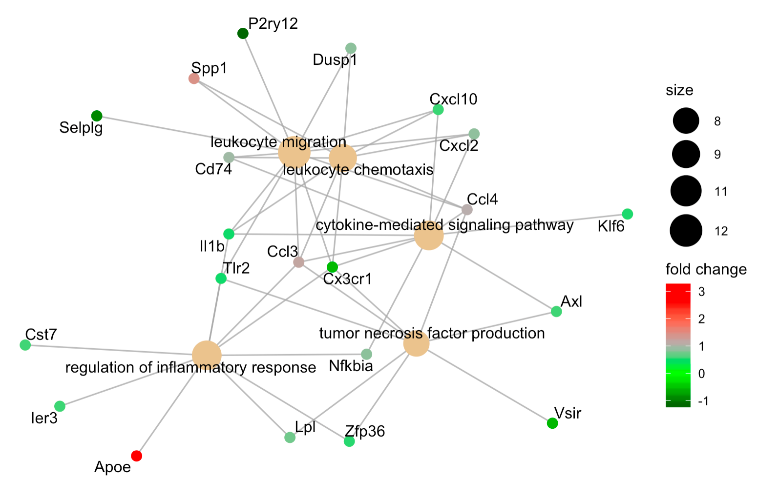
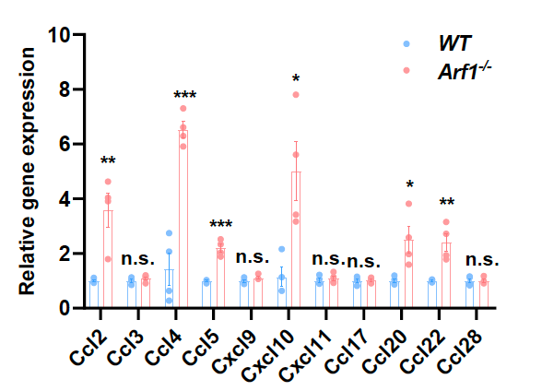
log

Slide 15
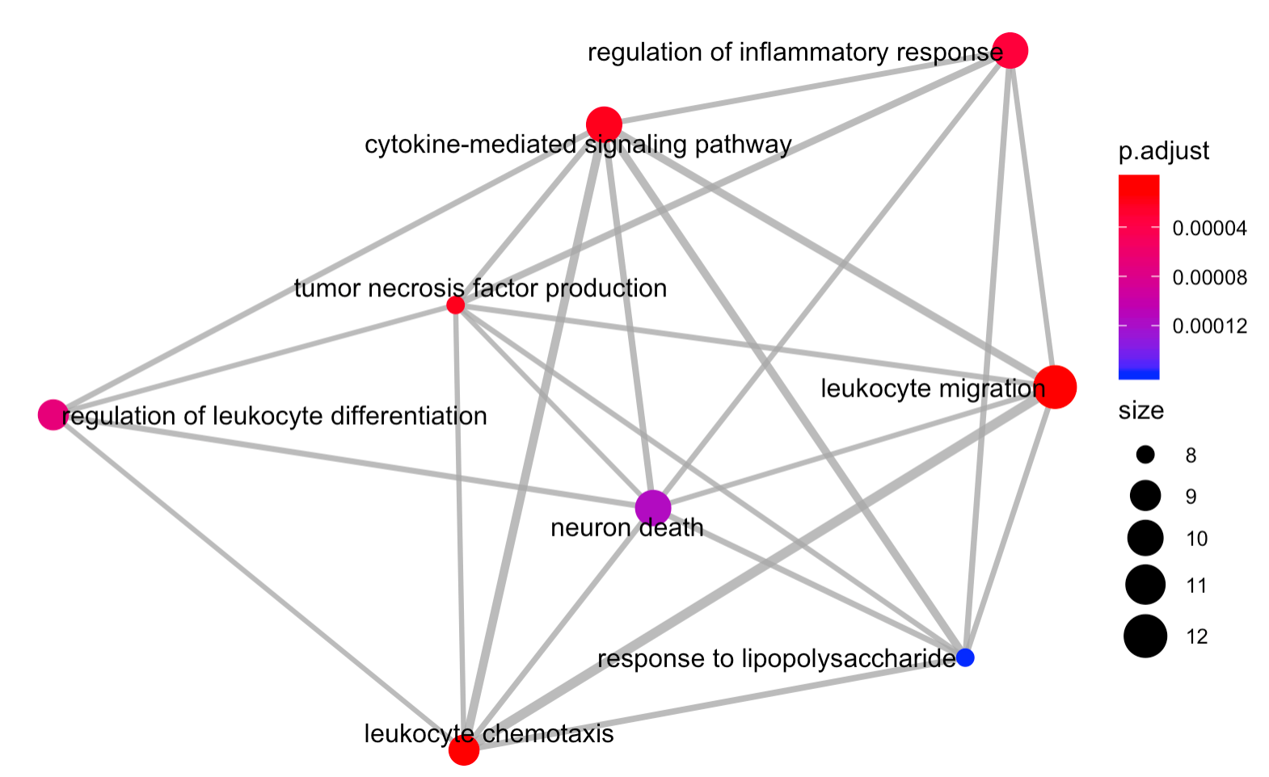
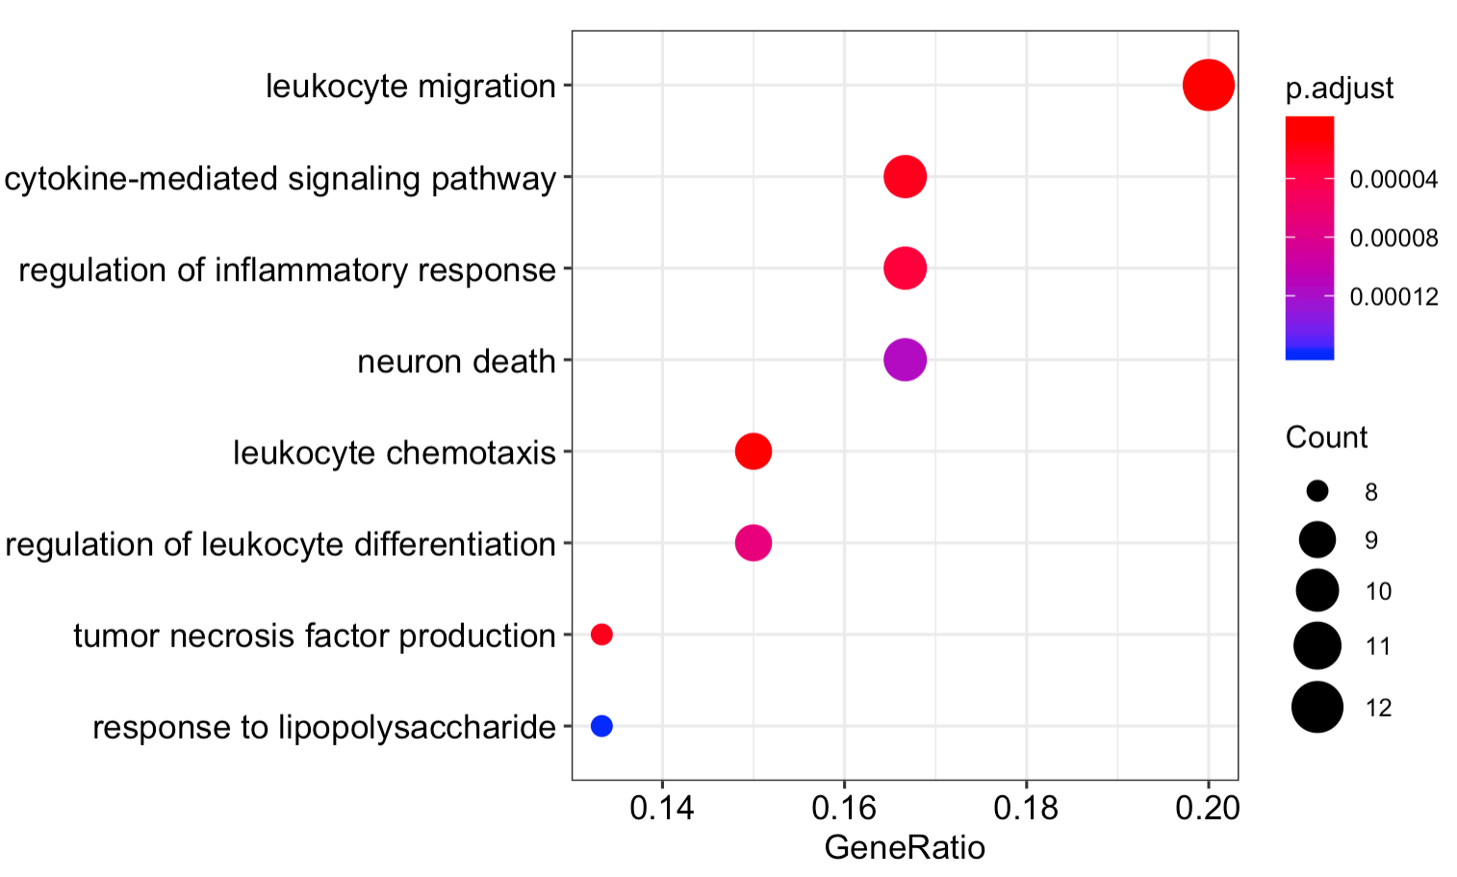
Cluster5 - enriched pathways
From file: myCluster5_cluster1_deg_ORA

Slide 16
To-do for Da
Plot that shows shift of cluster 1-5 for Arf1 and WT(density plot doesn’t look good, so will stick with bar plot)
Transfer microgliaReshape to Biowulf and FindAllMarker for each cluster(biowulf) and Doheatmap
Plot that shows Arf1 and WT cluster 5-1 degs are very similar (also INFg and Arf1_INFg)
Total of three to make: 1. Arf1-WT, Arf1-IFNg, Arf1-Arf1_IFNg, IFNg-WT, Arf1_IFNg-WT. (biowulf swarm job) 2. FindAllMarkers 3. Cluster5 – Cluster1
Heatmap(up and down-regulated genes for Cluster5 – Cluster1, and Arf1-WT degs),
Heatmap of cluster1-5 to show clustering

Slide 17
To do for Guohao
Look into myCluster5_cluster1_deg_ORA and decide which pathways to do dotplot, which ones to show network

